Slide 1



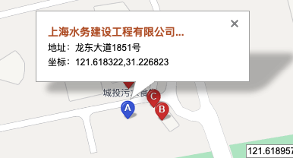
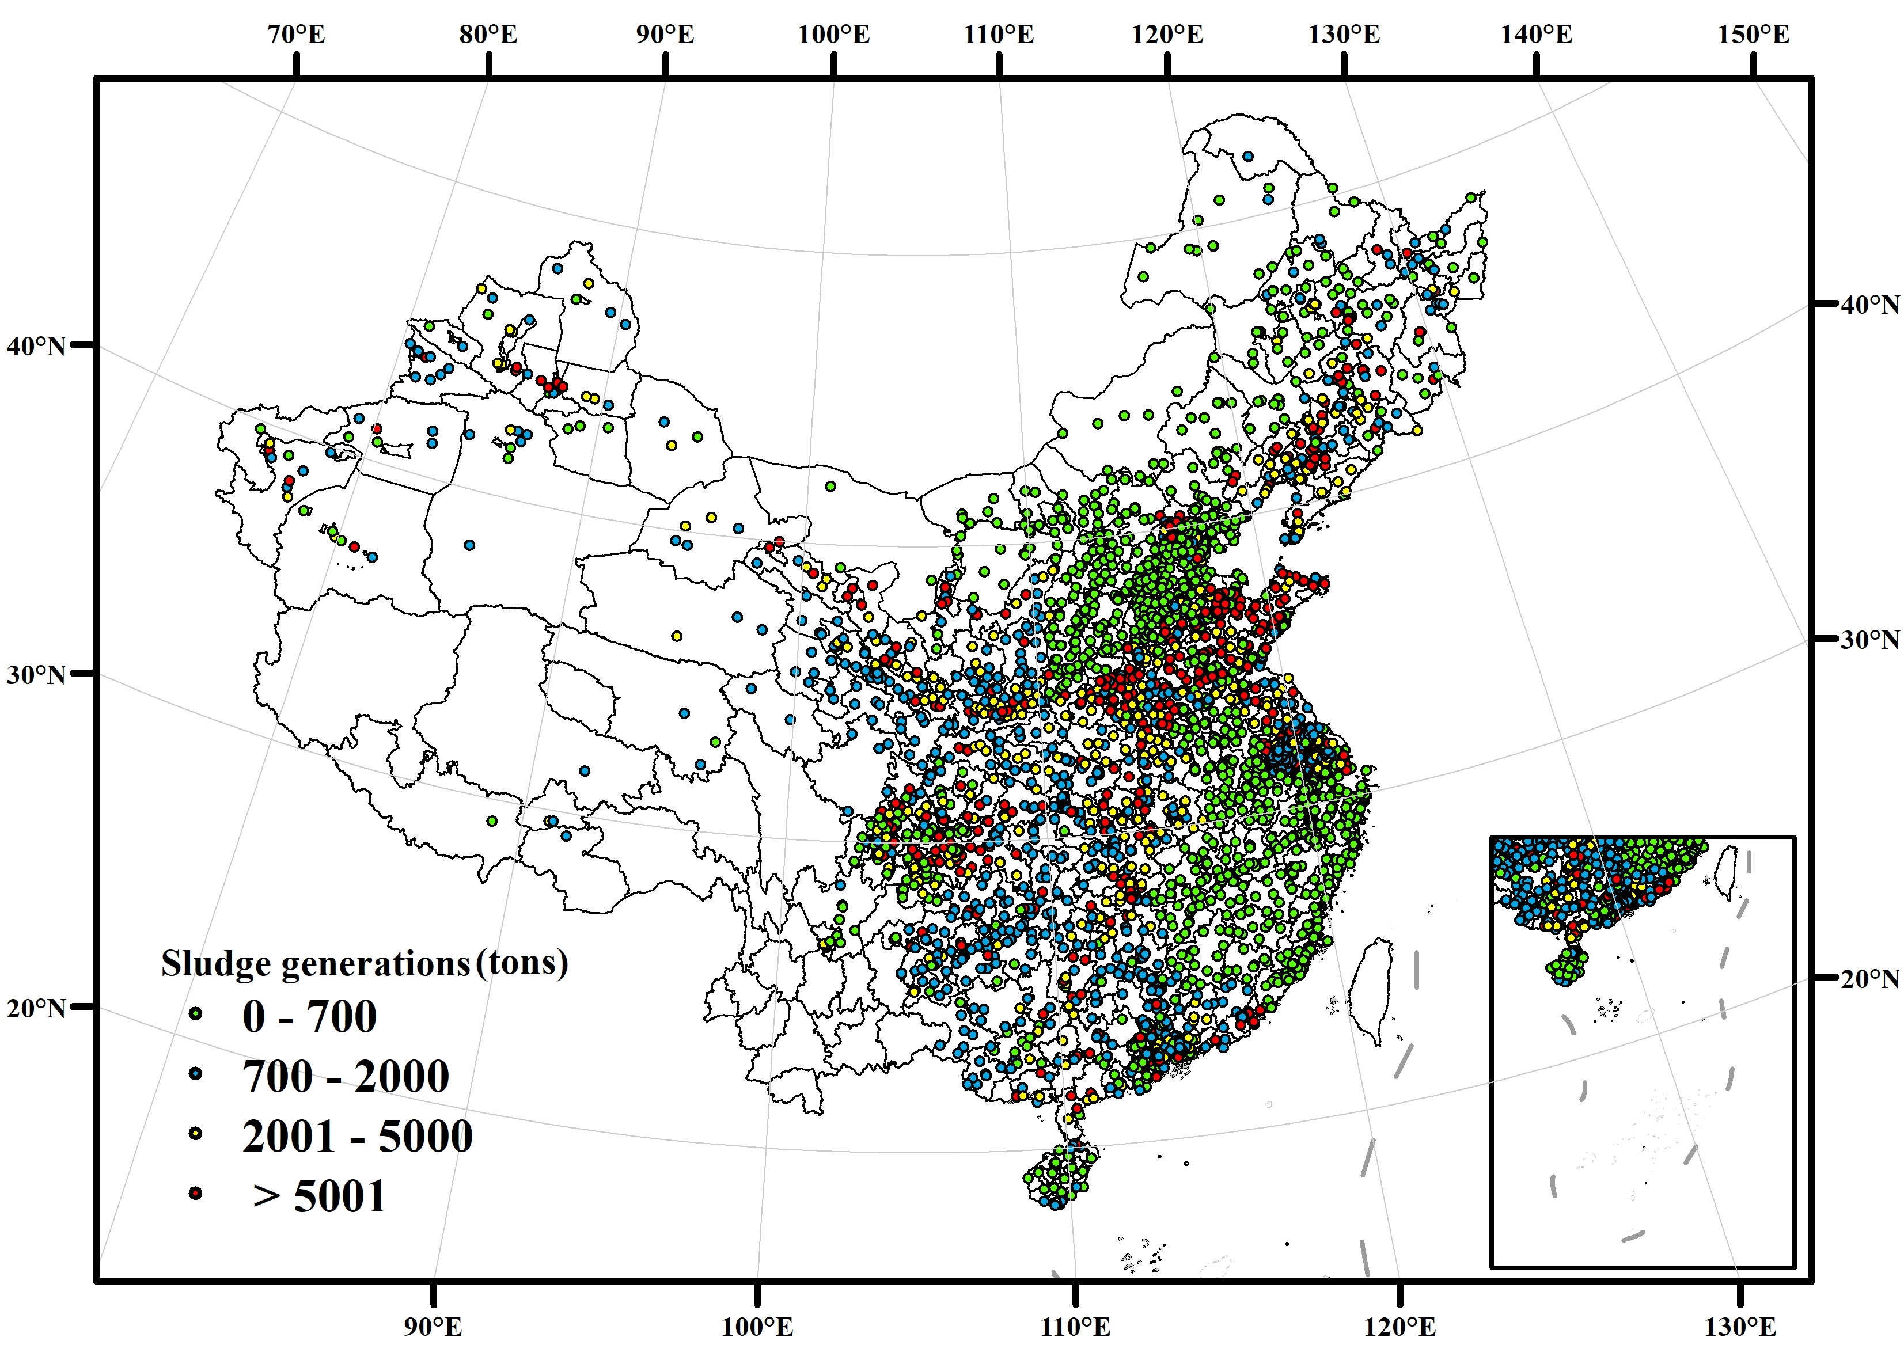
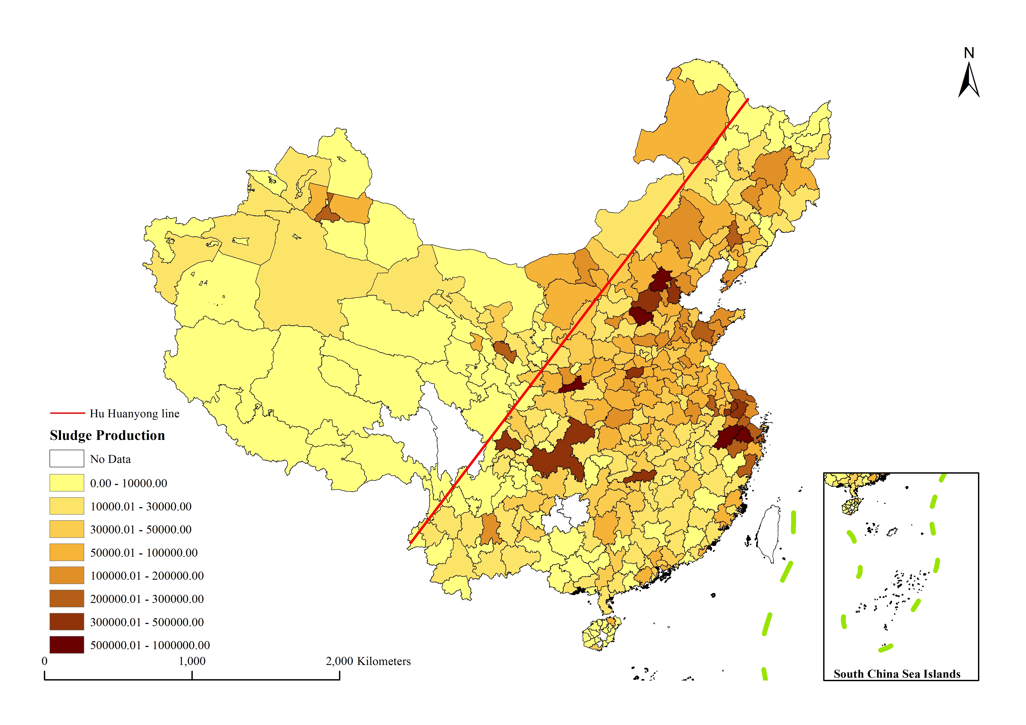
Address:
No. 1851, Longdong Avenue, Shanghai, China
Bailonggang Wastewater treatment plant
Calculation:
Collecting sludge data of each WWTPs. Filling the missing values by the flows of wastewater treatments.
Comparison:
Compare the sludge data we’ve calculated with Yearbooks.
Coordinate:
121.618322N, 31.226823E (BD09: Baidu Map)
Aggregating:
Aggregating all the sludge data at city level.
Correction:
Correcting data that has an obvious bias.
Plants Address
Sludge Data
Data Validation

Slide 2
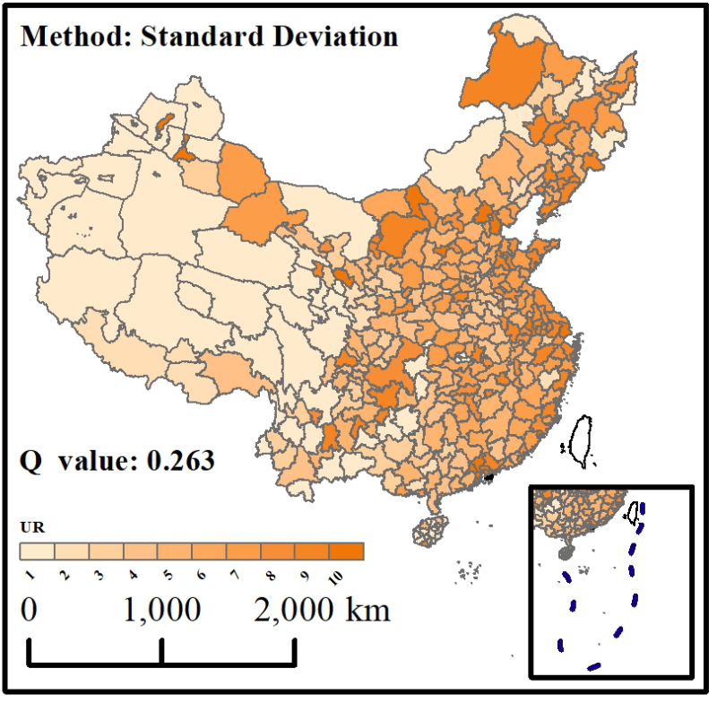
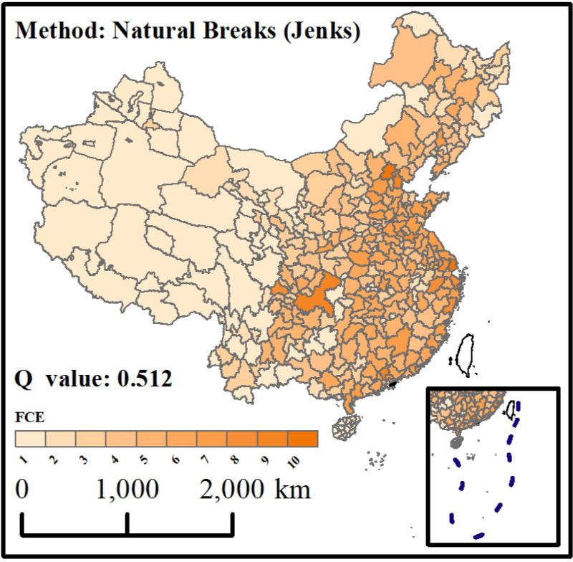

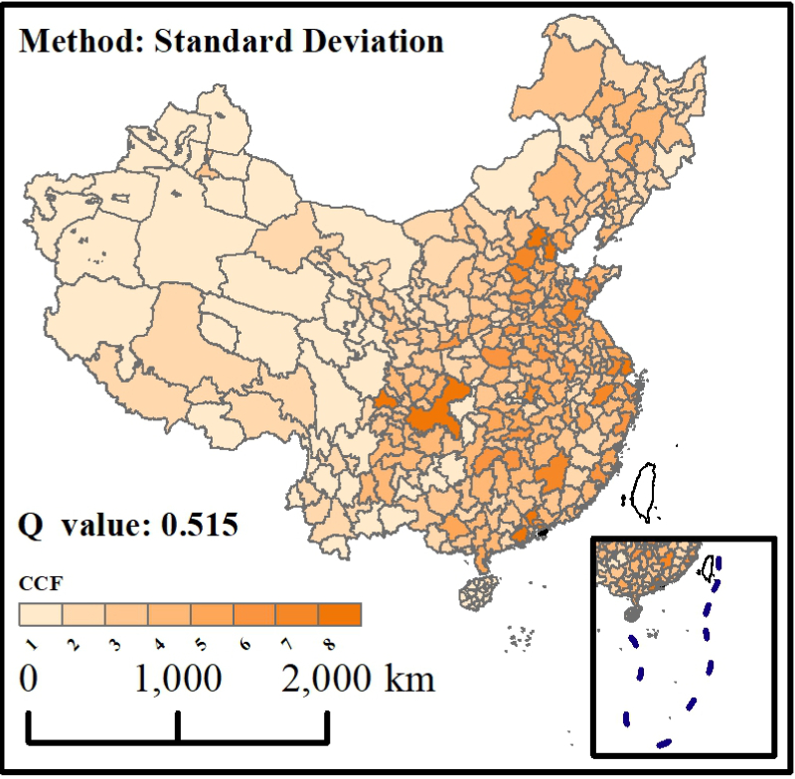
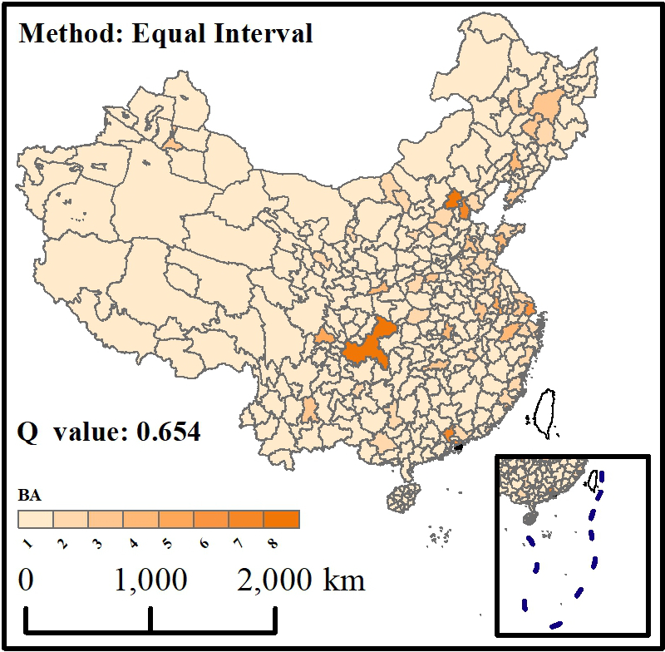
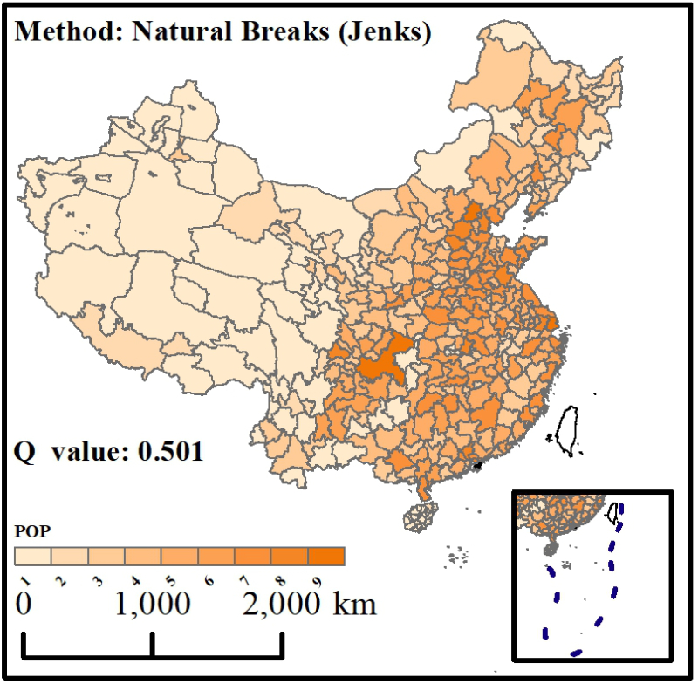
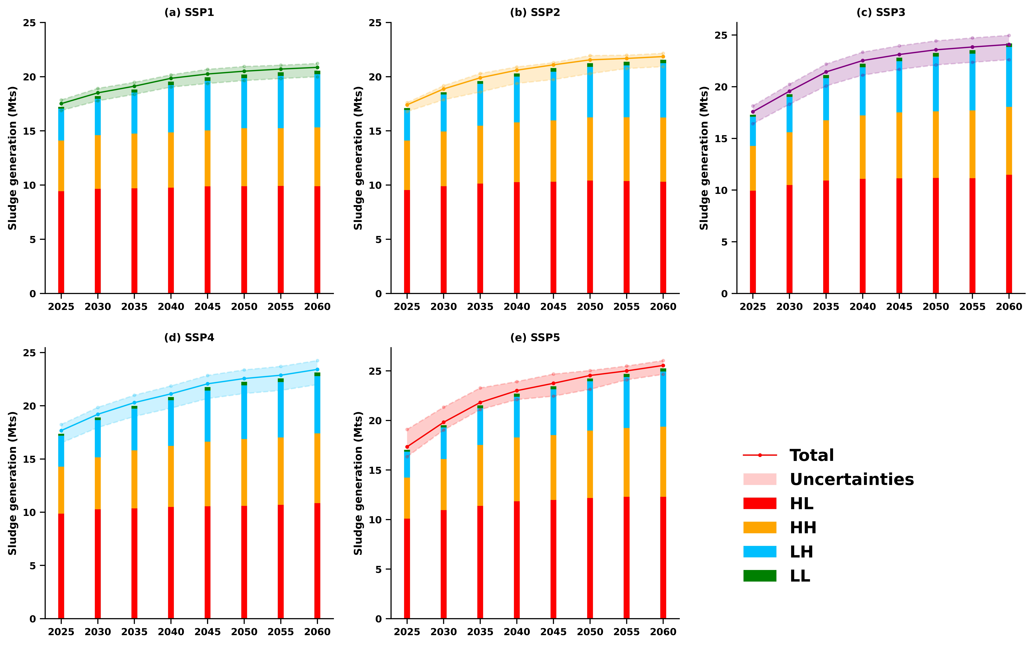
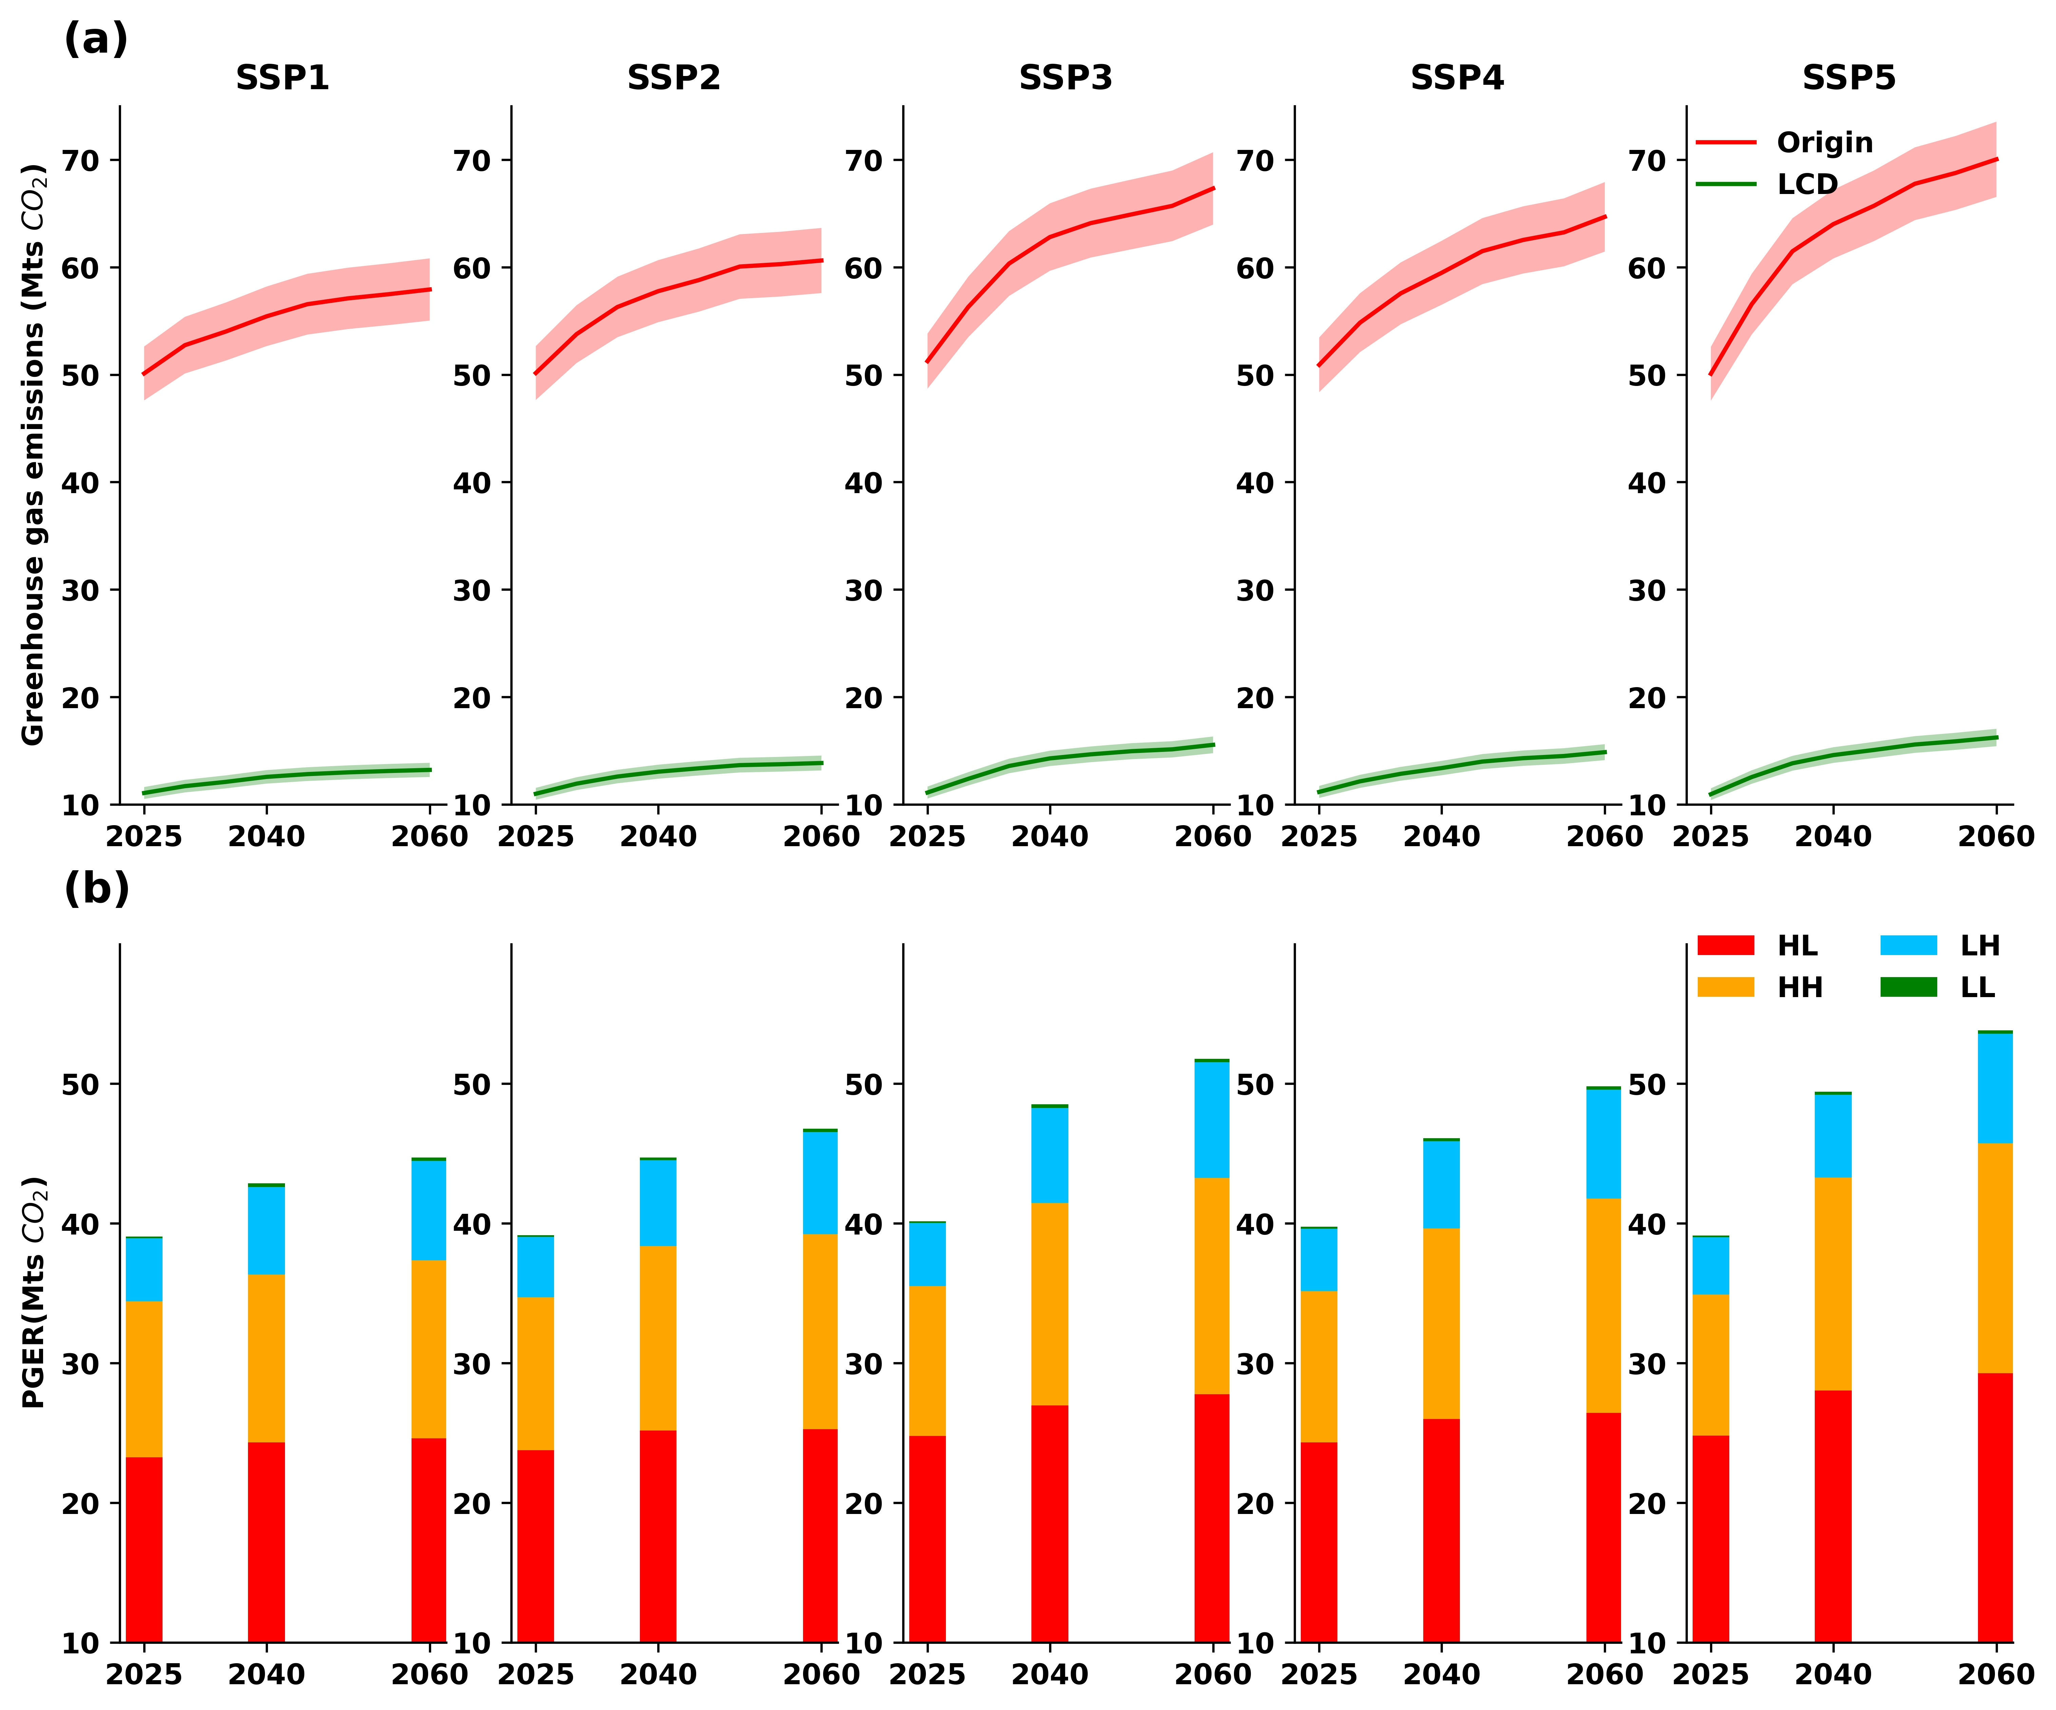
Sludge Generation
Driving Factors
Random Forest
GeoDetector
Regression
Sludge generation Future Trends GHG emission and its potential reduction
Shared Socio-economic Pathways
LCD refers to Low Carbon Disposal development which optimizes sludge disposal methods for low GHG emissions.
Total sludge generations
Uncertainties
High sludge generation with stable growth
High sludge generation with rapid growth
Low sludge generation with rapid growth
Low sludge generation with stable growth

Slide 3
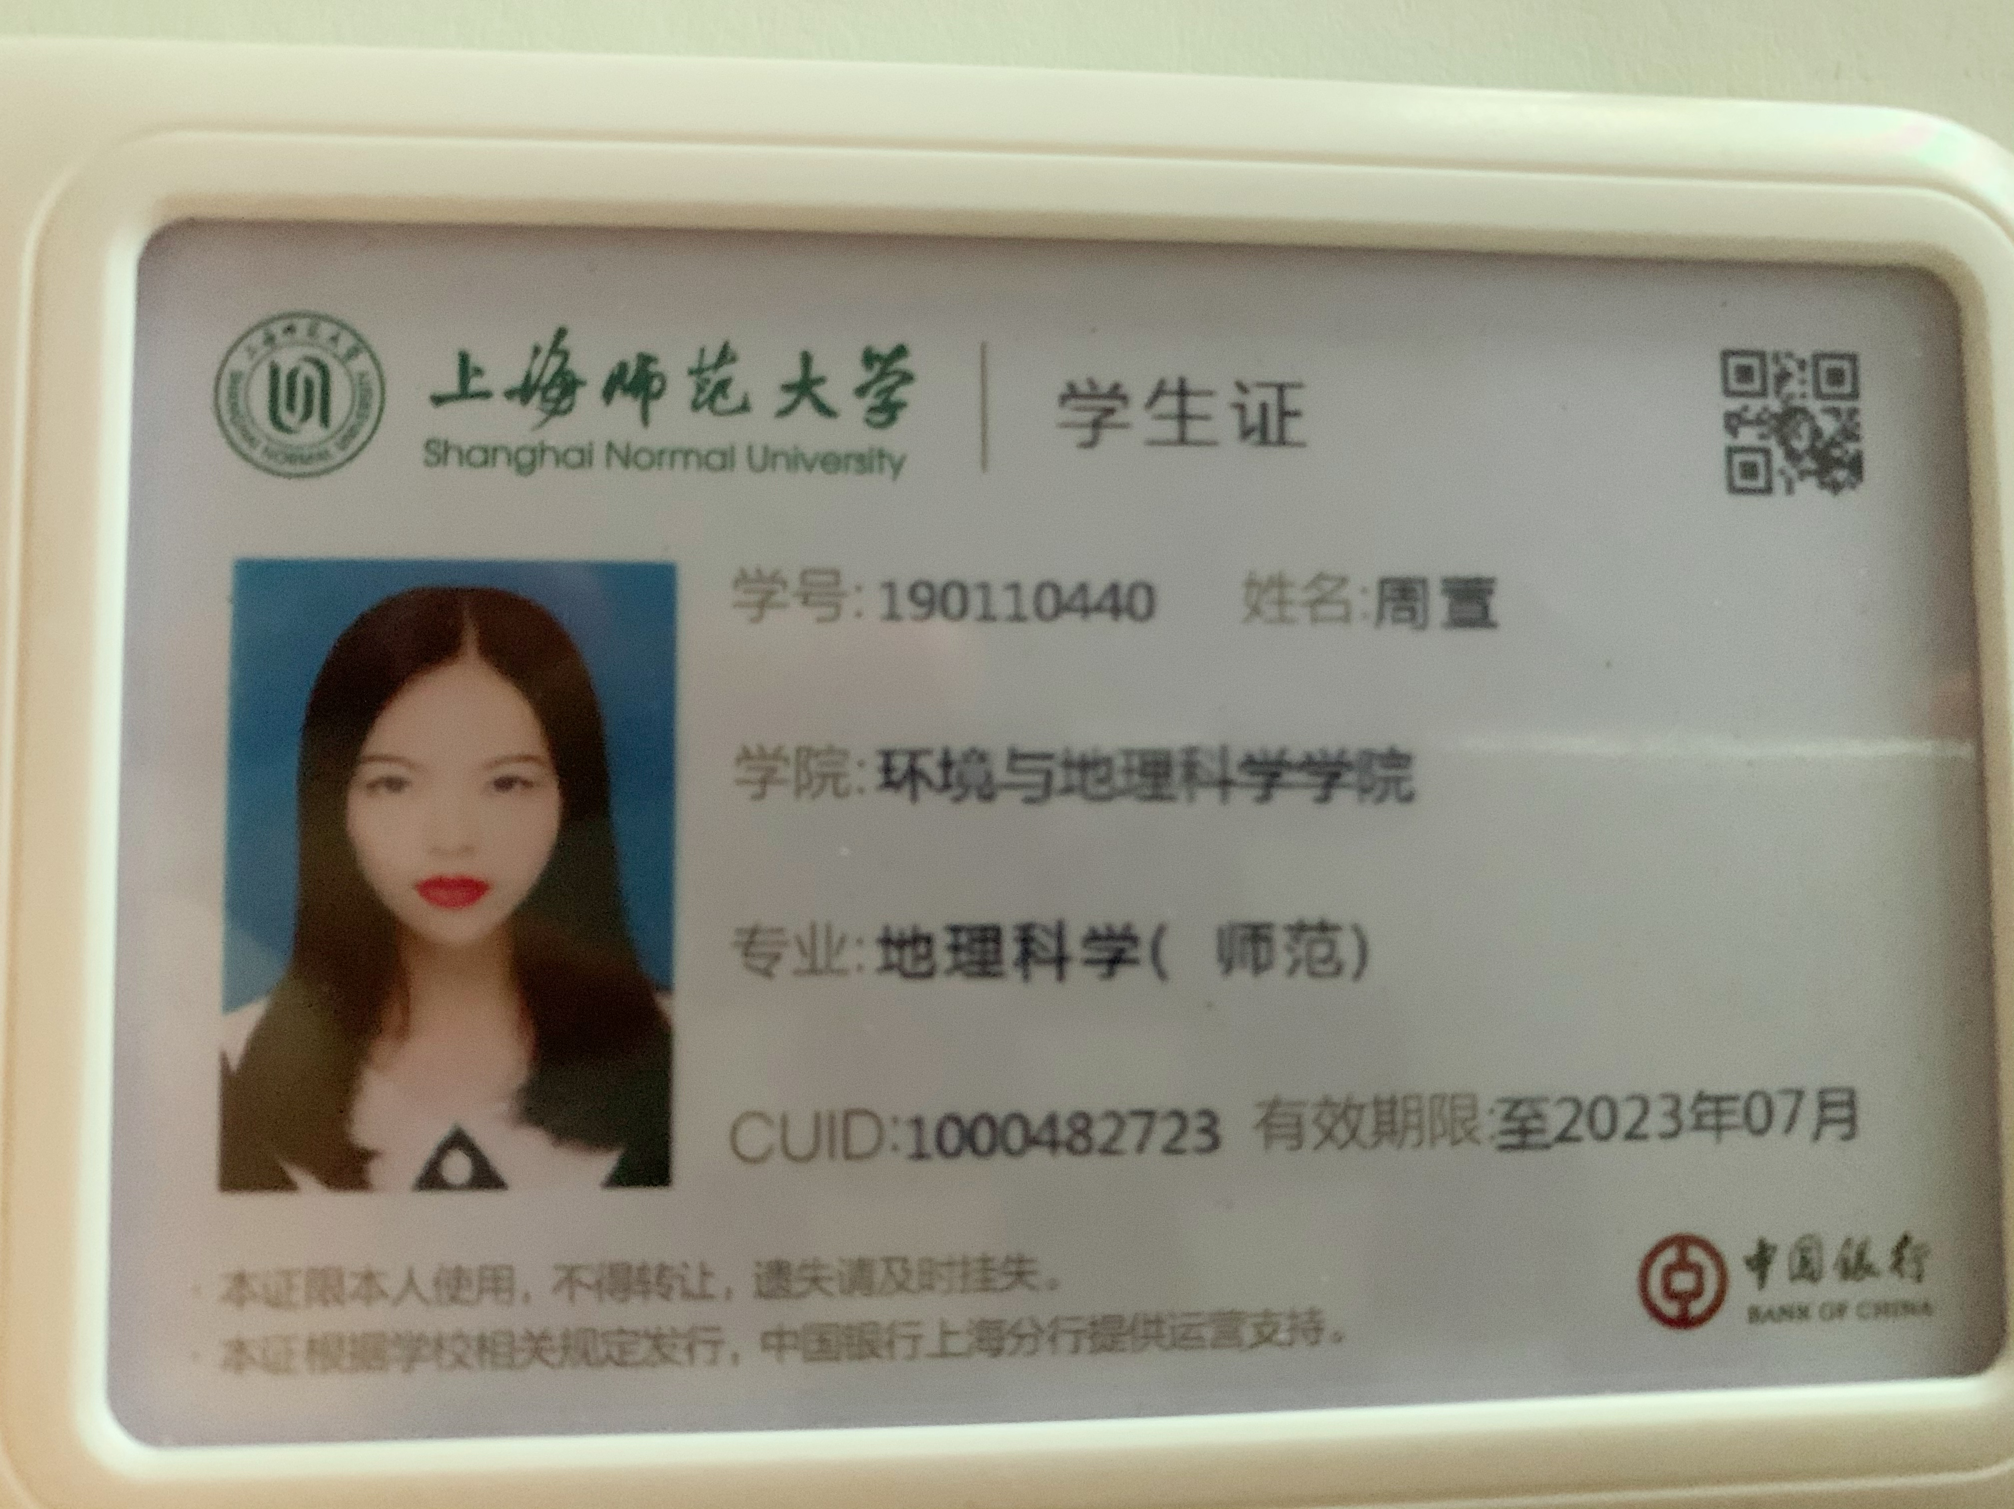
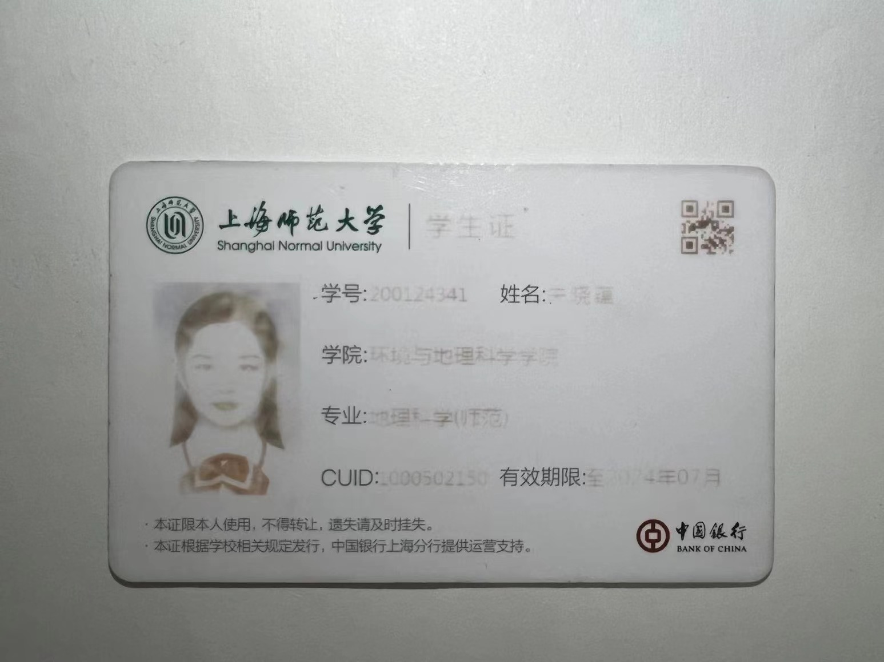
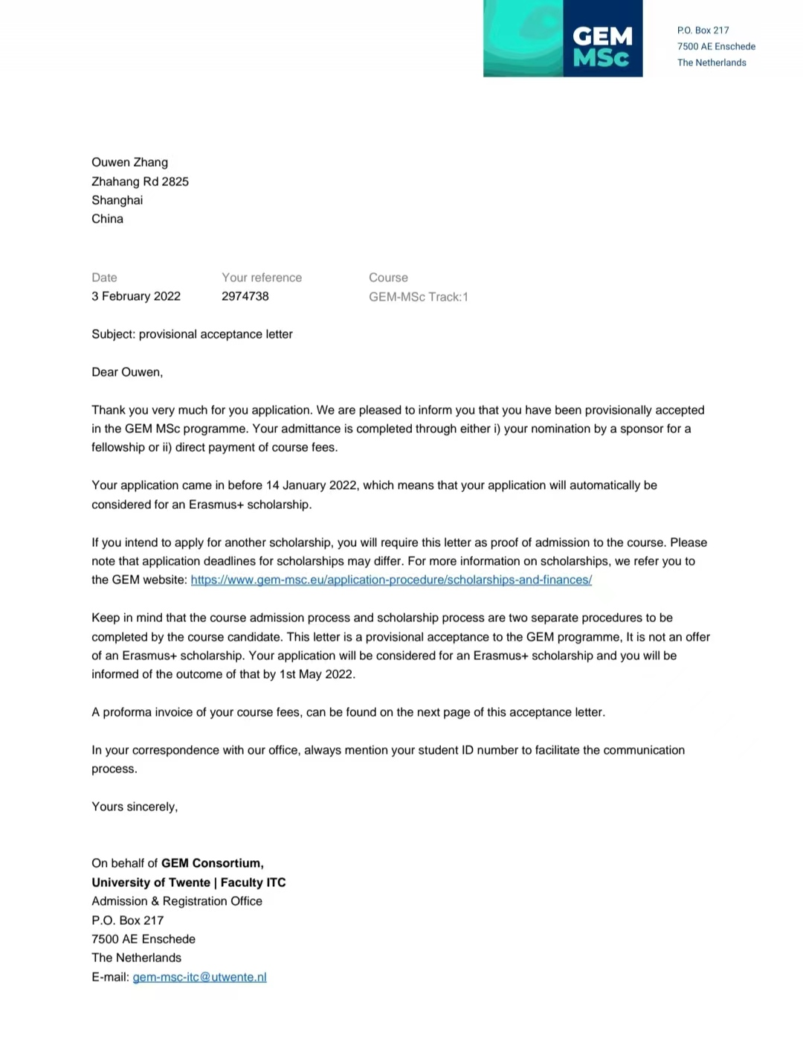
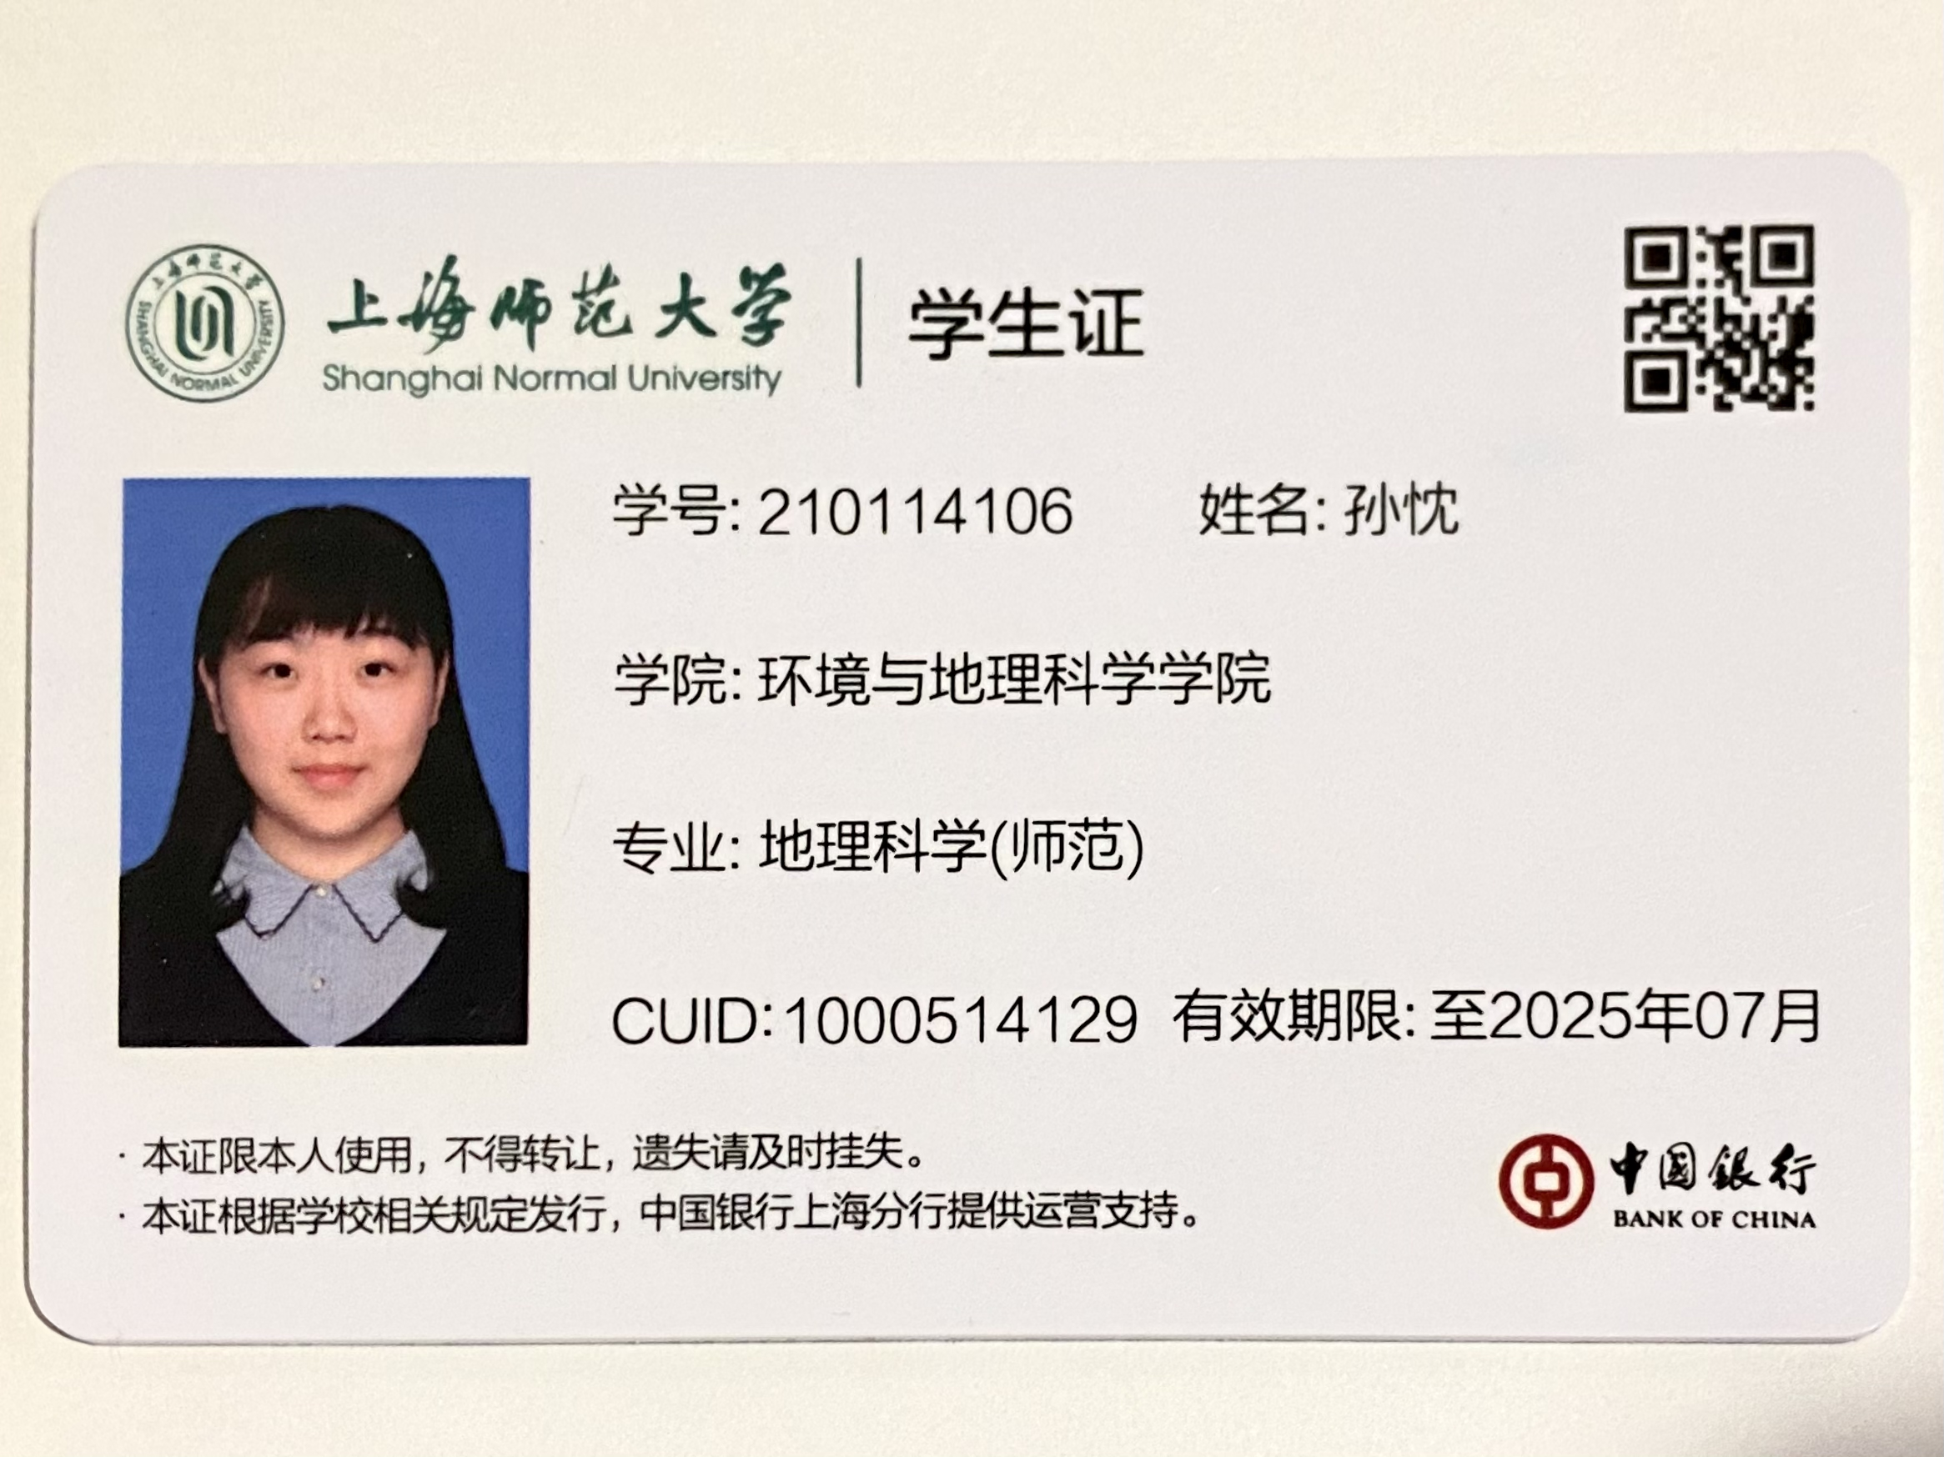
张欧文同学已毕业,目前研究生待入学(因疫情推迟)

